Slide 1
Karatsuba Multiplication
Let x and y be n-bit integers.
Split x and y into first n/2 bits (x_{L},y_{L}) and its last n/2 bits (x_{R},y_{R})
x = 2^{n/2} x_{L} + x_{R}
y = 2^{n/2} y_{L} + y_{R}
P₁ = x_{L} ∙ y_{L}
P₂ = x_{R} ∙ y_{R}
P₃ = (x_{L} + x_{R}) ∙ (y_{L} + y_{R})
= x_{L}∙y_{L} + x_{L}∙y_{R} + x_{R}∙y_{L} + x_{R}∙y_{R}
P₃ – P₁ – P₂ = x_{L}∙y_{R} + x_{R}∙y_{L}
Return P₁ ∙ 2^{n} + (P₃ – P₁ – P₂) ∙ 2^{n/2} + P₂
T(n) = 3 T(n/2) + O(n)
a = 3, b = 2, d = 1, log_{b}a = log₂3 > 1
T(n) is O(n^{log_2} ³) which is O(n^{1.59})

Slide 2
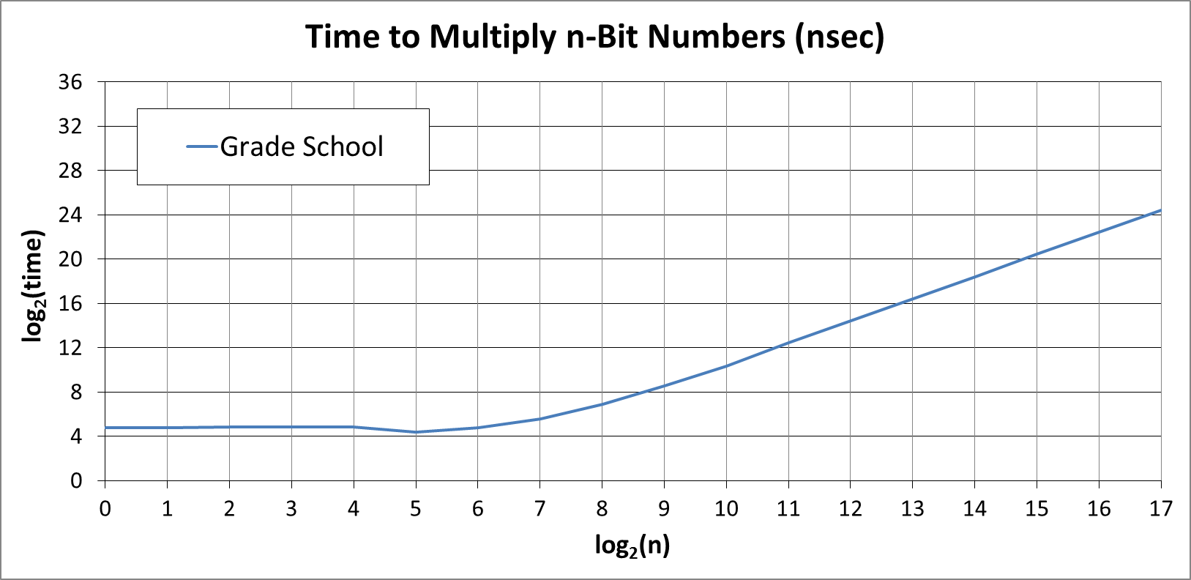
Grade School Multiplication
Compute average time to multiply pairs of n-bit integers for n = 2^{k}, where k = 0 … 17
What would you expect a plot of this to look like?

Slide 3
Grade School Multiplication
k | Grd Sch | Ratio
0 | 2.7E+01
1 | 2.7E+01 | 1.0
2 | 2.8E+01 | 1.0
3 | 2.8E+01 | 1.0
4 | 2.8E+01 | 1.0
5 | 2.1E+01 | 0.8
6 | 2.7E+01 | 1.3
7 | 4.7E+01 | 1.7
8 | 1.2E+02 | 2.6
9 | 3.7E+02 | 3.1
10 | 1.3E+03 | 3.5
11 | 5.4E+03 | 4.2
12 | 2.2E+04 | 4.1
13 | 8.6E+04 | 3.9
14 | 3.4E+05 | 4.0
15 | 1.4E+06 | 4.1
16 | 5.5E+06 | 3.9
17 | 2.2E+07 | 4.0
Average time to multiply pairs of n-bit integers in nanoseconds.

Slide 4
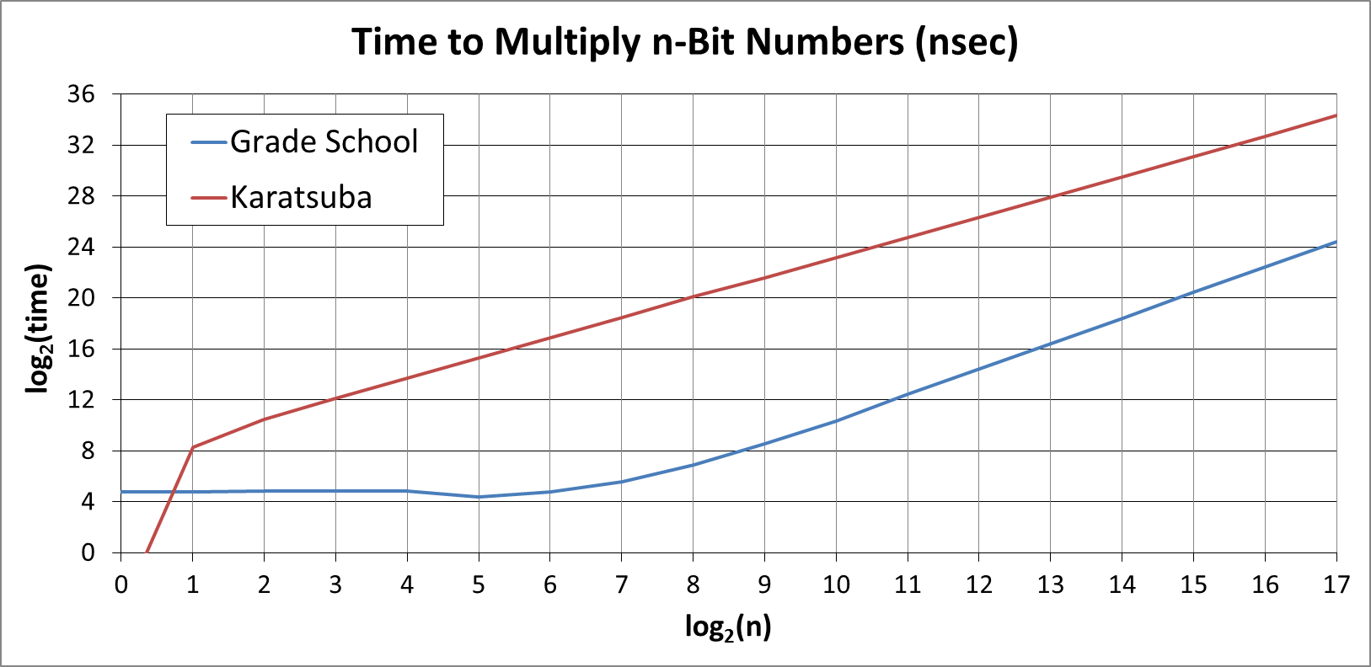
Karatsuba Multiplication
Compute average time to multiply pairs of n-bit integers for n = 2^{k}, where k = 0 … 17
What would you expect a plot of this to look like?

Slide 5
Karatsuba Multiplication
Average time to multiply pairs of n-bit integers in nanoseconds.
What do you expect the ratio to be for Karatsuba?
(2n)^{log_2} ³ / n^{log_2} ³ =
2^{log_2} ³ =
3
k | Grd Sch | Ratio | Karatsuba | Ratio
0 | 2.7E+01 |  | 4.4E-02
1 | 2.7E+01 | 1.0 | 3.1E+02 | 7045.5
2 | 2.8E+01 | 1.0 | 1.4E+03 | 4.5
3 | 2.8E+01 | 1.0 | 4.3E+03 | 3.1
4 | 2.8E+01 | 1.0 | 1.3E+04 | 3.0
5 | 2.1E+01 | 0.8 | 3.9E+04 | 3.0
6 | 2.7E+01 | 1.3 | 1.2E+05 | 3.1
7 | 4.7E+01 | 1.7 | 3.5E+05 | 2.9
8 | 1.2E+02 | 2.6 | 1.1E+06 | 3.1
9 | 3.7E+02 | 3.1 | 3.1E+06 | 2.8
10 | 1.3E+03 | 3.5 | 9.4E+06 | 3.0
11 | 5.4E+03 | 4.2 | 2.8E+07 | 3.0
12 | 2.2E+04 | 4.1 | 8.5E+07 | 3.0
13 | 8.6E+04 | 3.9 | 2.5E+08 | 2.9
14 | 3.4E+05 | 4.0 | 7.7E+08 | 3.1
15 | 1.4E+06 | 4.1 | 2.3E+09 | 3.0
16 | 5.5E+06 | 3.9 | 6.9E+09 | 3.0
17 | 2.2E+07 | 4.0 | 2.1E+10 | 3.0
k | Grd Sch | Ratio
0 | 2.7E+01
1 | 2.7E+01 | 1.0
2 | 2.8E+01 | 1.0
3 | 2.8E+01 | 1.0
4 | 2.8E+01 | 1.0
5 | 2.1E+01 | 0.8
6 | 2.7E+01 | 1.3
7 | 4.7E+01 | 1.7
8 | 1.2E+02 | 2.6
9 | 3.7E+02 | 3.1
10 | 1.3E+03 | 3.5
11 | 5.4E+03 | 4.2
12 | 2.2E+04 | 4.1
13 | 8.6E+04 | 3.9
14 | 3.4E+05 | 4.0
15 | 1.4E+06 | 4.1
16 | 5.5E+06 | 3.9
17 | 2.2E+07 | 4.0

Slide 6
Blended Multiplication
Since for large enough numbers, Karatsuba multiplication eventually is faster than grade school multiplication, we can blend them.
blendedMultiply (x, y)
if (|x| and |y| are both less than THRESHOLD)
return gradeSchoolMultiply(x, y)
else
split x into its halves x_{L} and x_{R}
split y into its halves y_{L} and y_{R}
P₁ = blendedMulitiply(x_{L}, y_{L})
P₂ = blendedMultiply(x_{R}, y_{R})
P₃ = blendedMultiply(x_{L}+x_{R}, y_{L}+y_{R})
return P₁ ∙ 2^{n} + (P₃ – P₁ – P₂) ∙ 2^{n/2} + P₂
This is possible because Karatsuba is divide and conquer
Need to think some more about x and y of very different lengths!

Slide 7
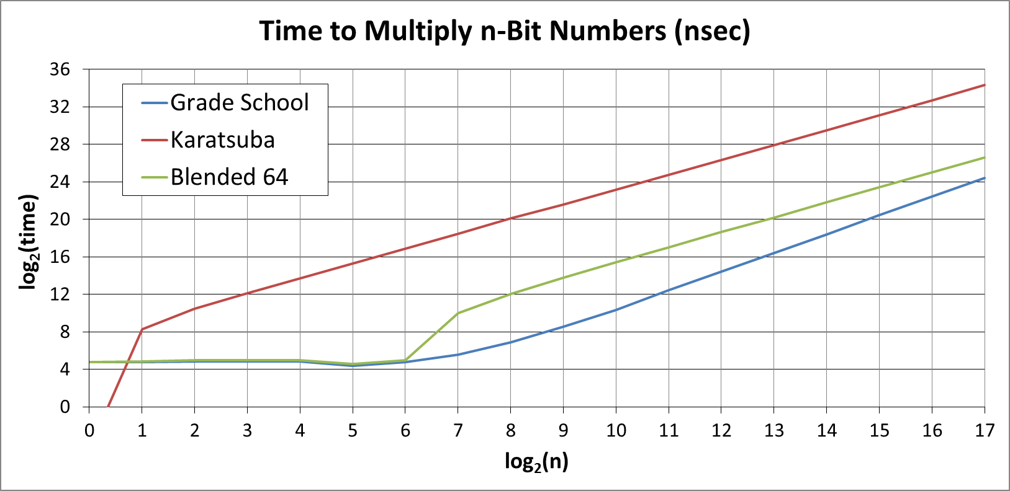
Blended 64 Multiplication
Compute average time to multiply pairs of n-bit integers for n = 2^{k}, where k = 0 … 17. Cutover at 64 bits.
What would you expect a plot of this to look like?

Slide 8
Blended 64 Multiplication
Average time to multiply pairs of n-bit integers in nanoseconds.
What do you expect the ratio to be for Blended 64?
k | Grd Sch | Ratio | Karatsuba | Ratio | Blend 64 | Ratio
0 | 2.7E+01 |  | 4.4E-02 |  | 2.7E+01
1 | 2.7E+01 | 1.0 | 3.1E+02 | 7045.5 | 2.8E+01 | 1.0
2 | 2.8E+01 | 1.0 | 1.4E+03 | 4.5 | 3.1E+01 | 1.1
3 | 2.8E+01 | 1.0 | 4.3E+03 | 3.1 | 3.1E+01 | 1.0
4 | 2.8E+01 | 1.0 | 1.3E+04 | 3.0 | 3.1E+01 | 1.0
5 | 2.1E+01 | 0.8 | 3.9E+04 | 3.0 | 2.4E+01 | 0.8
6 | 2.7E+01 | 1.3 | 1.2E+05 | 3.1 | 3.1E+01 | 1.3
7 | 4.7E+01 | 1.7 | 3.5E+05 | 2.9 | 1.0E+03 | 32.3
8 | 1.2E+02 | 2.6 | 1.1E+06 | 3.1 | 4.1E+03 | 4.1
9 | 3.7E+02 | 3.1 | 3.1E+06 | 2.8 | 1.4E+04 | 3.4
10 | 1.3E+03 | 3.5 | 9.4E+06 | 3.0 | 4.4E+04 | 3.1
11 | 5.4E+03 | 4.2 | 2.8E+07 | 3.0 | 1.3E+05 | 3.0
12 | 2.2E+04 | 4.1 | 8.5E+07 | 3.0 | 4.1E+05 | 3.2
13 | 8.6E+04 | 3.9 | 2.5E+08 | 2.9 | 1.2E+06 | 2.9
14 | 3.4E+05 | 4.0 | 7.7E+08 | 3.1 | 3.7E+06 | 3.1
15 | 1.4E+06 | 4.1 | 2.3E+09 | 3.0 | 1.1E+07 | 3.0
16 | 5.5E+06 | 3.9 | 6.9E+09 | 3.0 | 3.4E+07 | 3.1
17 | 2.2E+07 | 4.0 | 2.1E+10 | 3.0 | 1.0E+08 | 2.9
k | Grd Sch | Ratio | Karatsuba | Ratio
0 | 2.7E+01 |  | 4.4E-02
1 | 2.7E+01 | 1.0 | 3.1E+02 | 7045.5
2 | 2.8E+01 | 1.0 | 1.4E+03 | 4.5
3 | 2.8E+01 | 1.0 | 4.3E+03 | 3.1
4 | 2.8E+01 | 1.0 | 1.3E+04 | 3.0
5 | 2.1E+01 | 0.8 | 3.9E+04 | 3.0
6 | 2.7E+01 | 1.3 | 1.2E+05 | 3.1
7 | 4.7E+01 | 1.7 | 3.5E+05 | 2.9
8 | 1.2E+02 | 2.6 | 1.1E+06 | 3.1
9 | 3.7E+02 | 3.1 | 3.1E+06 | 2.8
10 | 1.3E+03 | 3.5 | 9.4E+06 | 3.0
11 | 5.4E+03 | 4.2 | 2.8E+07 | 3.0
12 | 2.2E+04 | 4.1 | 8.5E+07 | 3.0
13 | 8.6E+04 | 3.9 | 2.5E+08 | 2.9
14 | 3.4E+05 | 4.0 | 7.7E+08 | 3.1
15 | 1.4E+06 | 4.1 | 2.3E+09 | 3.0
16 | 5.5E+06 | 3.9 | 6.9E+09 | 3.0
17 | 2.2E+07 | 4.0 | 2.1E+10 | 3.0

Slide 9
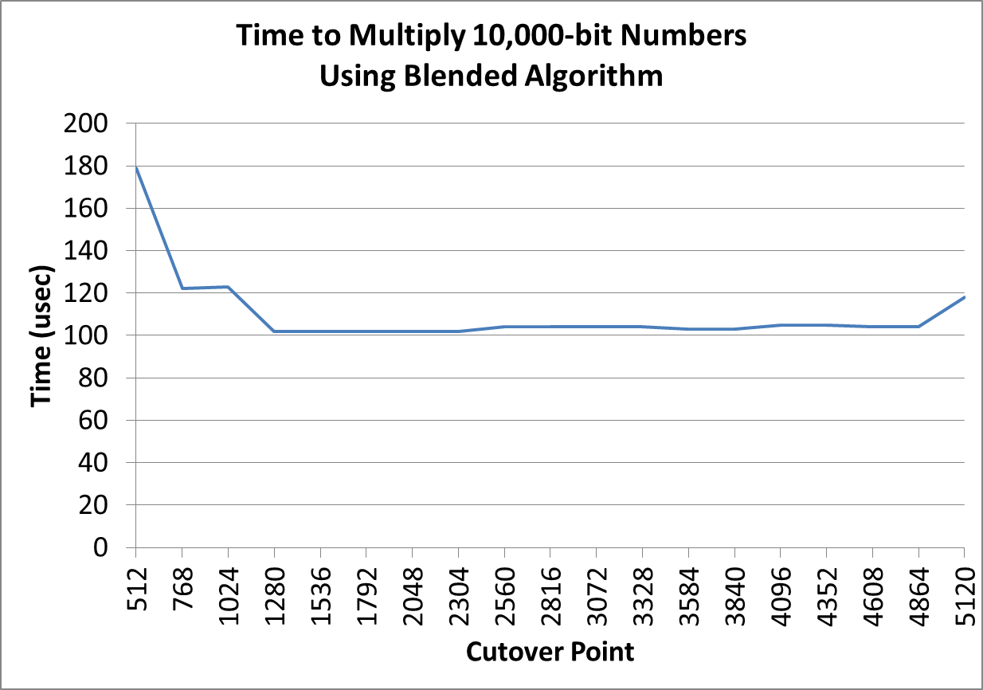
Blended Multiplication
What should the threshold be?
Computed the average time to do a blended multiplication on pairs of 10,000-bit numbers using a threshold ranging from 512 to 2048 in steps of 256.
What do you think of this experiment for determining threshold?

Slide 10
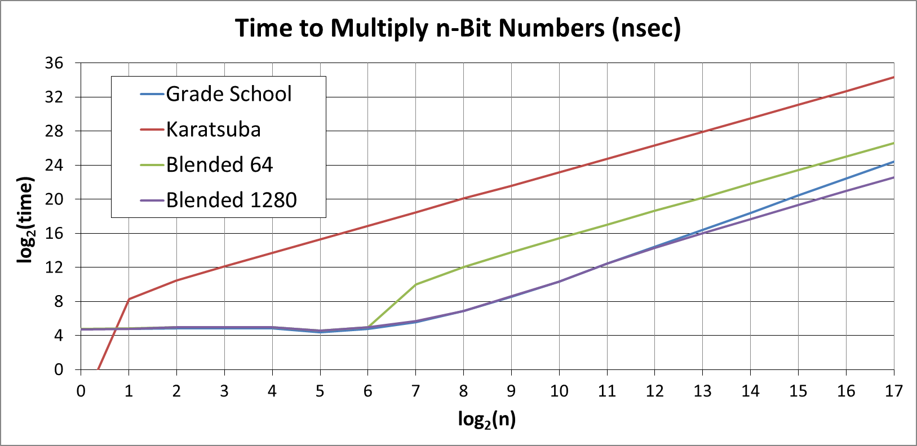
Blended 1280 Multiplication
Compute average time to multiply pairs of n-bit integers for n = 2^{k}, where k = 0 … 17. Used threshold of 1280
What would you expect a plot of this to look like?

Slide 11
Blended Multiplication
k | Grd Sch | Ratio | Karatsuba | Ratio | Blend 64 | Ratio | Blend 1280 | Ratio
0 | 2.7E+01 |  | 4.4E-02 |  | 2.7E+01 |  | 2.6E+01
1 | 2.7E+01 | 1.0 | 3.1E+02 | 7045.5 | 2.8E+01 | 1.0 | 2.7E+01 | 1.0
2 | 2.8E+01 | 1.0 | 1.4E+03 | 4.5 | 3.1E+01 | 1.1 | 3.1E+01 | 1.1
3 | 2.8E+01 | 1.0 | 4.3E+03 | 3.1 | 3.1E+01 | 1.0 | 3.1E+01 | 1.0
4 | 2.8E+01 | 1.0 | 1.3E+04 | 3.0 | 3.1E+01 | 1.0 | 3.1E+01 | 1.0
5 | 2.1E+01 | 0.8 | 3.9E+04 | 3.0 | 2.4E+01 | 0.8 | 2.4E+01 | 0.8
6 | 2.7E+01 | 1.3 | 1.2E+05 | 3.1 | 3.1E+01 | 1.3 | 3.1E+01 | 1.3
7 | 4.7E+01 | 1.7 | 3.5E+05 | 2.9 | 1.0E+03 | 32.3 | 5.1E+01 | 1.6
8 | 1.2E+02 | 2.6 | 1.1E+06 | 3.1 | 4.1E+03 | 4.1 | 1.2E+02 | 2.4
9 | 3.7E+02 | 3.1 | 3.1E+06 | 2.8 | 1.4E+04 | 3.4 | 3.8E+02 | 3.2
10 | 1.3E+03 | 3.5 | 9.4E+06 | 3.0 | 4.4E+04 | 3.1 | 1.3E+03 | 3.4
11 | 5.4E+03 | 4.2 | 2.8E+07 | 3.0 | 1.3E+05 | 3.0 | 5.6E+03 | 4.3
12 | 2.2E+04 | 4.1 | 8.5E+07 | 3.0 | 4.1E+05 | 3.2 | 2.0E+04 | 3.6
13 | 8.6E+04 | 3.9 | 2.5E+08 | 2.9 | 1.2E+06 | 2.9 | 6.7E+04 | 3.4
14 | 3.4E+05 | 4.0 | 7.7E+08 | 3.1 | 3.7E+06 | 3.1 | 2.1E+05 | 3.1
15 | 1.4E+06 | 4.1 | 2.3E+09 | 3.0 | 1.1E+07 | 3.0 | 6.6E+05 | 3.1
16 | 5.5E+06 | 3.9 | 6.9E+09 | 3.0 | 3.4E+07 | 3.1 | 2.0E+06 | 3.0
17 | 2.2E+07 | 4.0 | 2.1E+10 | 3.0 | 1.0E+08 | 2.9 | 6.1E+06 | 3.1
k | Grd Sch | Ratio | Karatsuba | Ratio | Blend 64 | Ratio
0 | 2.7E+01 |  | 4.4E-02 |  | 2.7E+01
1 | 2.7E+01 | 1.0 | 3.1E+02 | 7045.5 | 2.8E+01 | 1.0
2 | 2.8E+01 | 1.0 | 1.4E+03 | 4.5 | 3.1E+01 | 1.1
3 | 2.8E+01 | 1.0 | 4.3E+03 | 3.1 | 3.1E+01 | 1.0
4 | 2.8E+01 | 1.0 | 1.3E+04 | 3.0 | 3.1E+01 | 1.0
5 | 2.1E+01 | 0.8 | 3.9E+04 | 3.0 | 2.4E+01 | 0.8
6 | 2.7E+01 | 1.3 | 1.2E+05 | 3.1 | 3.1E+01 | 1.3
7 | 4.7E+01 | 1.7 | 3.5E+05 | 2.9 | 1.0E+03 | 32.3
8 | 1.2E+02 | 2.6 | 1.1E+06 | 3.1 | 4.1E+03 | 4.1
9 | 3.7E+02 | 3.1 | 3.1E+06 | 2.8 | 1.4E+04 | 3.4
10 | 1.3E+03 | 3.5 | 9.4E+06 | 3.0 | 4.4E+04 | 3.1
11 | 5.4E+03 | 4.2 | 2.8E+07 | 3.0 | 1.3E+05 | 3.0
12 | 2.2E+04 | 4.1 | 8.5E+07 | 3.0 | 4.1E+05 | 3.2
13 | 8.6E+04 | 3.9 | 2.5E+08 | 2.9 | 1.2E+06 | 2.9
14 | 3.4E+05 | 4.0 | 7.7E+08 | 3.1 | 3.7E+06 | 3.1
15 | 1.4E+06 | 4.1 | 2.3E+09 | 3.0 | 1.1E+07 | 3.0
16 | 5.5E+06 | 3.9 | 6.9E+09 | 3.0 | 3.4E+07 | 3.1
17 | 2.2E+07 | 4.0 | 2.1E+10 | 3.0 | 1.0E+08 | 2.9
Average time to multiply pairs of n-bit integers in nanoseconds.
What do you expect ratio to look like?

